Slide 1


Student Hub
Affiliated college website
The college website is a one-stop platform for students, faculty, and staff, offering essential information, resources, and services. It serves as a comprehensive hub for accessing crucial academic and administrative support. With its user-friendly interface, the website facilitates seamless navigation and efficient communication within the college community. It plays a vital role in enhancing the overall experience and productivity of its users.

Slide 2
Purpose of the website
1
Information Dissemination
2
Resource Access
The website acts as a central hub for sharing essential college-related updates, notifications, and announcements.
Students and faculty can easily access study materials, course schedules, and academic resources.
3
Exam Results
4
Attendance
Website stores the all results and give access to see their results directly
Efficiently mantains the Student attendance for there semesters.

Slide 3
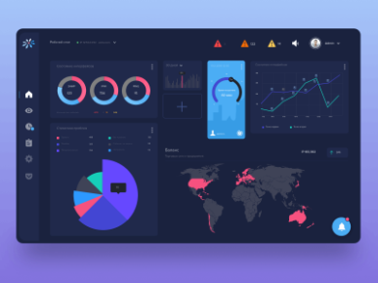

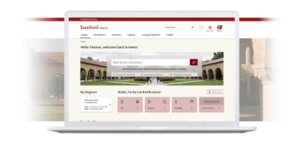
Features of the website
Interactive Dashboard
Student Information System
Faculty Portal
Provides an intuitive dashboard displaying personalized information and quick links.
All-in-one access to student records, profiles, and academic results.
Enables faculty to manage courses, attendance , and communicate with students.

Slide 4
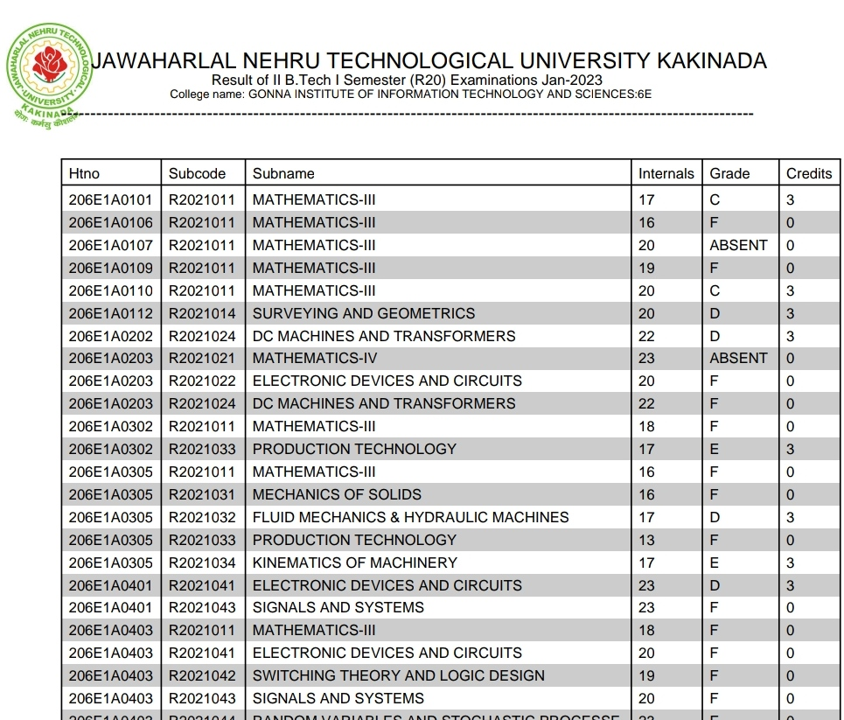


Existing method
At present the colleges which are under JNTUK or JNTU GV did not have officaial college websites. So the students are facing many consequences moreover in result system.

Slide 5

Result management system
1
Automated Result Generation
The system automatically calculates and generates students' results based on the input received from faculty.
2
Real-time Result Publication
Enables instant publication of results as soon as they are available, ensuring transparency and swift access.
3
Feedback Mechanism
Allows students to provide feedback and report discrepancies related to their published results.

Slide 6
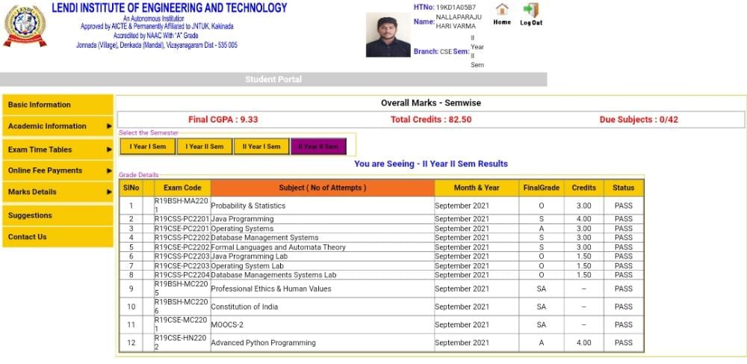

Slide 7
ALGORITHM
STEP-1: Collect result data from the university.
STEP-2: Convert the pdf data into excel data and then import the excel data to a database.
STEP-3: Collect the attendance data and other related data from college which are necessary to make a website.
STEP-4: Using front end, back end and using a database create a user friendly website for students, teachers and administration.

Slide 8
Attendance management system
Automated Attendance Tracking
Tracks student attendance in real-time using their credentials
Report Generation
Generates detailed reports on student attendance for faculty and administration.
Alerts & Notifications
Sends automated alerts to students and parents in case of irregular attendance.

Slide 9
User roles and permissions
Administrator
Faculty
Has access to all features and functionalities in the system, including user management and configurations.
Can manage attendance,study materials, and Imortand nottes.
Student
Can view results,academic records, course materials and their attendance.

Slide 10
Security measures
1
Role-based Access Control
2
Data Encryption
Ensures that each user can only access information and perform actions relevant to their role.
All sensitive data, including student records and results, is encrypted to prevent unauthorized access.
3
Student access
Students may gain access to the portal through the utilization of their respective credentials(Roll Number and DOB).

Slide 11

CONCLUSION
This presentation is about making college websites better to fit the changing needs of students and faculty. It talks about designing the websites with users in mind, making them easy to use and accessible to everyone. We'll learn how to improve the experience for users, like making the design work well on different devices and showing content that's tailored to each person. By looking at real examples and data, we'll get practical advice on how colleges can use their websites to help students succeed and improve the college's reputation.

Slide 12
Thank you
From team
Yadlapalli Phani Venkata Bhargavi
Koduru Neel kumar
Pavani talitara
Nallaparaju Hari varma
Chalumuri Adithya

